Slide 1

ARTIFICIAL INTELLIGENCE
&
MACHINE LEARNING
SESSION NO : 25

Slide 2
Decision Tree
A decision tree is a supervised learning algorithm used for classification and regression tasks. It has a hierarchical tree structure which consists of a root node, branches, internal nodes and leaf nodes.
It works like a flowchart help to make decisions step by step where:
  Root node represents the whole dataset.
  Internal nodes represent where decisions are made based on data feature.
  Branches represent the flow from one decision to another
  Leaf nodes represent final decisions or predictions.

Slide 3
Decision Tree
Decision trees are widely used due to their interpretability, flexibility and low preprocessing needs.
A learned decision tree can also be re-represented as a set of if-then rules.
Decision tree learning is one of the most widely used and practical methods for inductive inference.
It is robust to noisy data and capable of learning disjunctive expressions

Slide 4
Algorithm for Decision Tree Induction
Basic algorithm (a greedy algorithm)
  Tree is constructed in a top-down recursive divide-and-conquer manner
  At start, all the training examples are at the root
  Attributes are categorical (if continuous-valued, they are discretized in advance)
  Examples are partitioned recursively based on selected attributes
  Test attributes are selected on the basis of a heuristic or statistical measure (e.g., information gain)
Conditions for stopping partitioning
  All samples for a given node belong to the same class
  If no remaining attributes for further partitioning – majority voting is employed for classifying
  There are no samples left

Slide 5
Decision Tree Induction: An Example
Training data set: Buys_computer
The data set follows an example of Quinlan’s ID3 (Playing Tennis)
Resulting tree:
age?
<=30
overcast
>40
31..40
student?
yes
credit rating?
no
yes
excellent
fair
no
yes
no
yes

Slide 6
Splitting Based on Nominal Attributes
Multi-way split: Use as many partitions as distinct values.
Binary split: Divides values into two subsets.
Need to find optimal partitioning.
CarType
Family
Luxury
Sports
CarType
CarType
{Sports, Luxury}
{Family,
Luxury}
{Family}
OR
{Sports}

Slide 7
Splitting Based on Ordinal Attributes
Multi-way split: Use as many partitions as distinct values.
Binary split: Divides values into two subsets.
Need to find optimal partitioning.
Size
Small
Large
Medium
Size
Size
{Small, Medium}
OR
{Medium,
Large}
{Large}
{Small}
Size
{Small, Large}
{Medium}

Slide 8
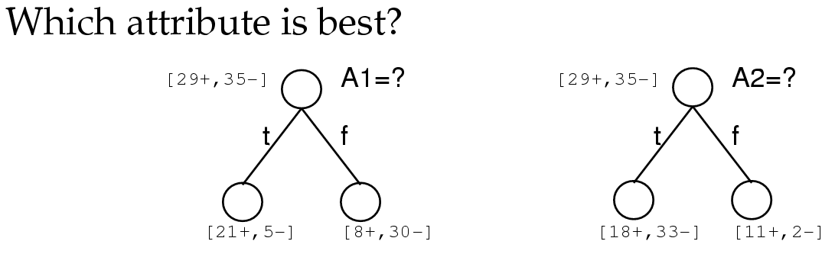
Choosing the Best Attribute
A1 and A2 are “attributes” (i.e. features or inputs).
Number +
and – examples
before and after
a split.
- Many different frameworks for choosing BEST have been proposed!
- We will look at Entropy Gain.

Slide 9
Decision Tree Training
Decision tree training is the process of learning the rules and structure of a decision tree model from input data.
The goal is to split the data in such a way that we can make accurate predictions based on the features.
Splitting Criteria:
  Entropy
  Information Gain
  Gain Ratio

Slide 10
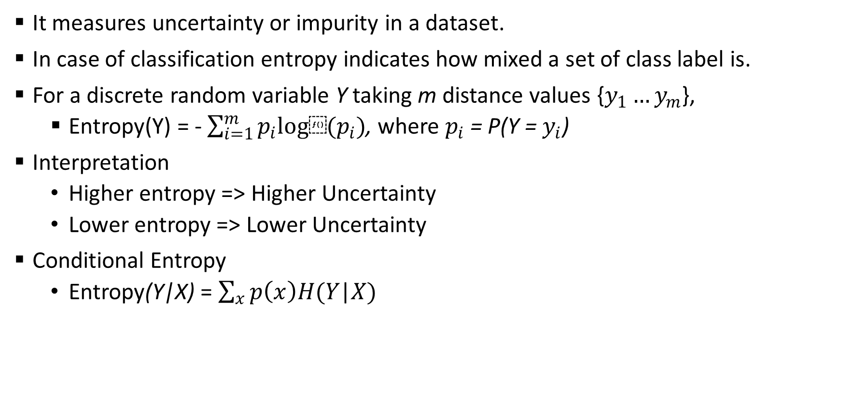
Entropy
It measures uncertainty or impurity in a dataset.
In case of classification entropy indicates how mixed a set of class label is.
For a discrete random variable Y taking m distance values {$y_{1}…y_{m}$},
  Entropy(Y) = - $\sum_{i=1}^{m}{p_{i}log⁡(p_{i})}$, where $p_{i}$ = P(Y = $y_{i}$)
Interpretation
  Higher entropy => Higher Uncertainty
  Lower entropy => Lower Uncertainty
Conditional Entropy
  Entropy(Y|X) = $\sum_{x}{p\left(x\right)H(Y\text{|}X)}$

Slide 11
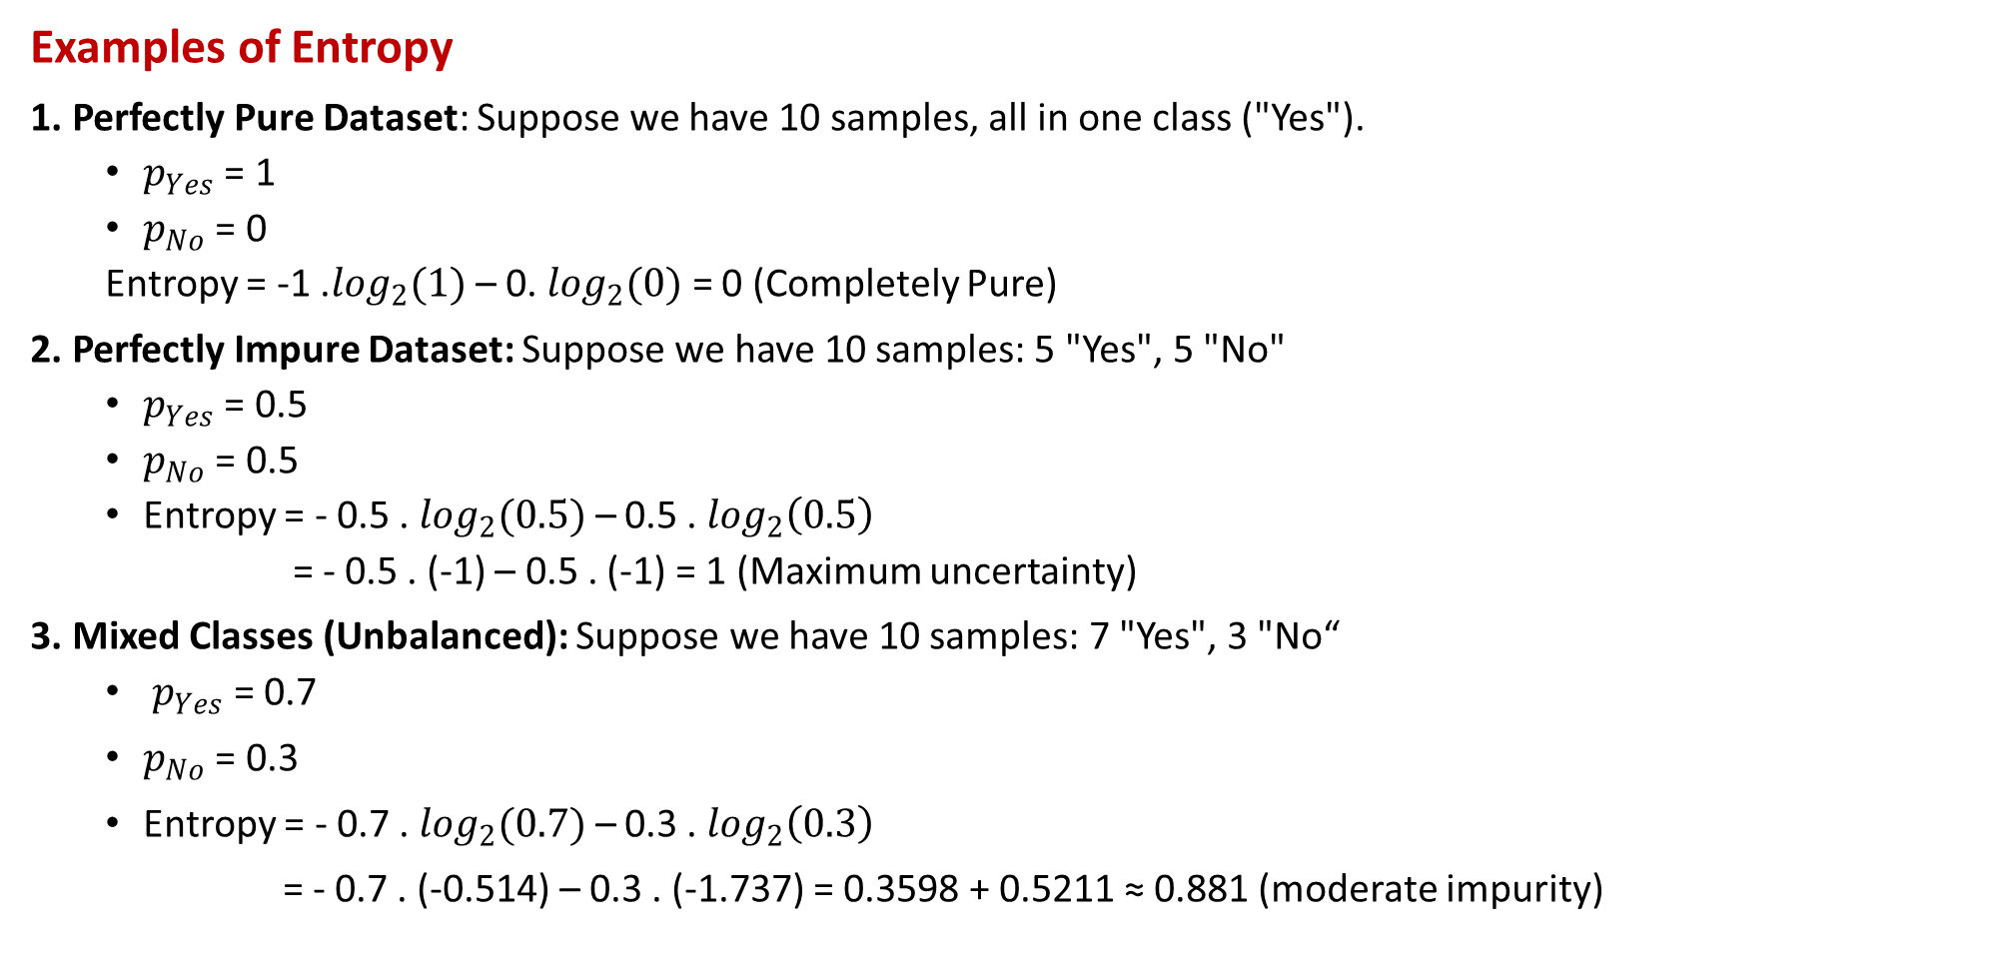
Entropy
Examples of Entropy
1. Perfectly Pure Dataset: Suppose we have 10 samples, all in one class ("Yes").
  $p_{Yes}$ = 1
  $p_{No}$ = 0
  Entropy = -1 .$\log_{2}(1)$ – 0. $\log_{2}(0)$ = 0 (Completely Pure)
2. Perfectly Impure Dataset: Suppose we have 10 samples: 5 "Yes", 5 "No"
  $p_{Yes}$ = 0.5
  $p_{No}$ = 0.5
  Entropy = - 0.5 . $\log_{2}(0.5)$ – 0.5 . $\log_{2}\left(0.5\right)$
  = - 0.5 . (-1) – 0.5 . (-1) = 1 (Maximum uncertainty)
3. Mixed Classes (Unbalanced): Suppose we have 10 samples: 7 "Yes", 3 "No“
  $p_{Yes}$ = 0.7
    $p_{No}$ = 0.3
    Entropy = - 0.7 . $\log_{2}(0.7)$ – 0.3 . $\log_{2}\left(0.3\right)$
    = - 0.7 . (-0.514) – 0.3 . (-1.737) = 0.3598 + 0.5211 ≈ 0.881 (moderate impurity)

Slide 12
Entropy
Example of Entropy: Play Tennis Dataset
Suppose we want to decide whether to play tennis based on the weather.
Outlook | Play Tennis
Sunny | No
Sunny | No
Overcast | Yes
Rain | Yes
Rain | Yes
Rain | No
Overcast | Yes
Sunny | Yes
Sunny | Yes
Rain | Yes

Slide 13
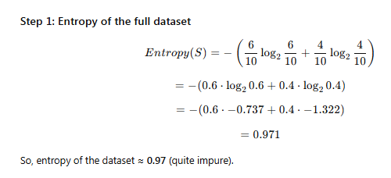
Entropy
Total samples = 10
Yes = 6
No = 4

Slide 14
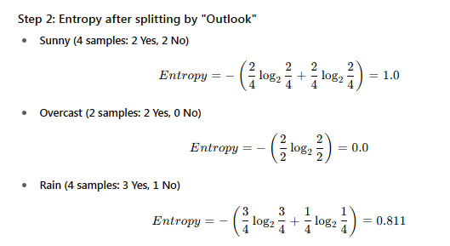
Entropy

Slide 15
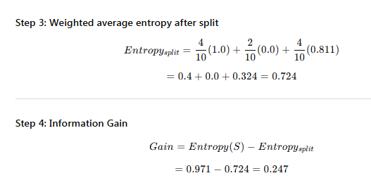
Entropy

Slide 16
Entropy
So, splitting on Outlook gives us an information gain of 0.247.
The feature with the highest gain will be chosen for the split.

Slide 17
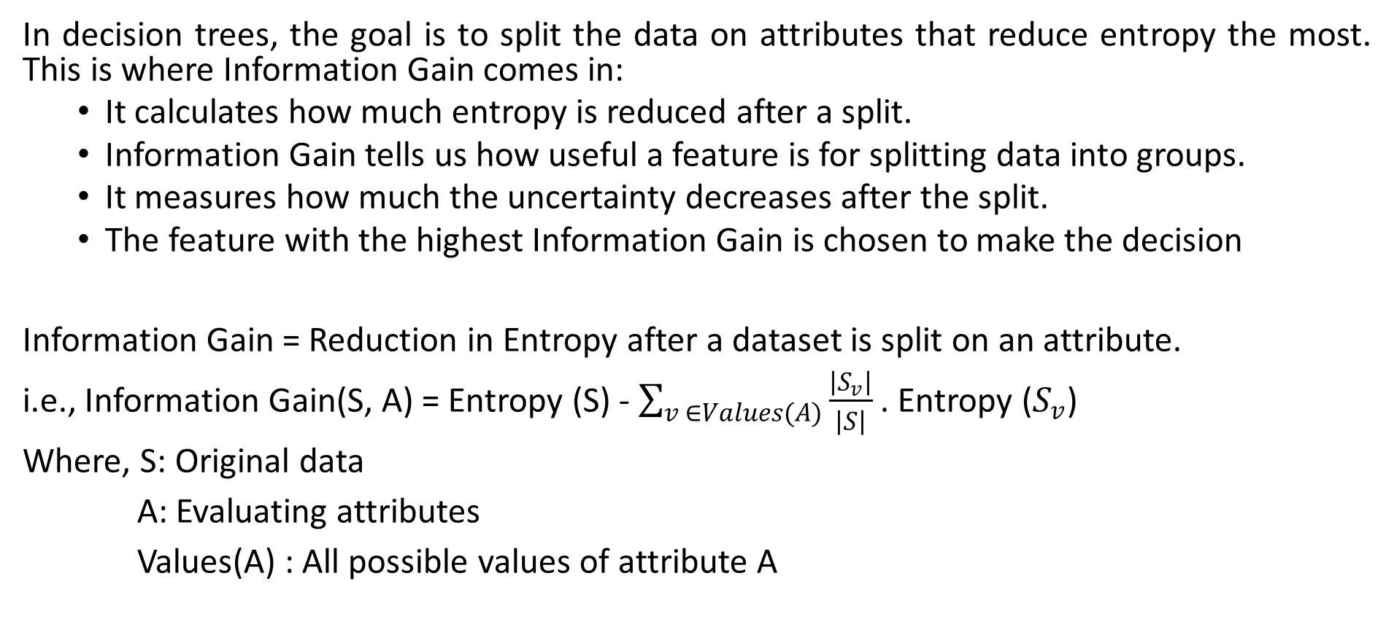
Information Gain
In decision trees, the goal is to split the data on attributes that reduce entropy the most. This is where Information Gain comes in:
  It calculates how much entropy is reduced after a split.
  Information Gain tells us how useful a feature is for splitting data into groups.
  It measures how much the uncertainty decreases after the split.
  The feature with the highest Information Gain is chosen to make the decision
Information Gain = Reduction in Entropy after a dataset is split on an attribute.
i.e., Information Gain(S, A) = Entropy (S) - $\sum_{v ∈Values(A)}{\frac{\left|S_{v}\right|}{\left|S\right|}}$ . Entropy ($S_{v}$)
Where, S: Original data
A: Evaluating attributes
Values(A) : All possible values of attribute A

Slide 18
Information Gain Example
 | O | T | H | W | Play?
1 | S | H | H | W | -
2 | S | H | H | S | -
3 | O | H | H | W | +
4 | R | M | H | W | +
5 | R | C | N | W | +
6 | R | C | N | S | -
7 | O | C | N | S | +
8 | S | M | H | W | -
9 | S | C | N | W | +
10 | R | M | N | W | +
11 | S | M | N | S | +
12 | O | M | H | S | +
13 | O | H | N | W | +
14 | R | M | H | S | -
Outlook: S(unny),
O(vercast),
R(ainy)
Temperature: H(ot), M(edium),
C(ool)
Humidity: H(igh),
N(ormal),
L(ow)
Wind: S(trong),
W(eak)
Question: Will I Play Today?

Slide 19

Information Gain Example
 | O | T | H | W | Play?
1 | S | H | H | W | -
2 | S | H | H | S | -
3 | O | H | H | W | +
4 | R | M | H | W | +
5 | R | C | N | W | +
6 | R | C | N | S | -
7 | O | C | N | S | +
8 | S | M | H | W | -
9 | S | C | N | W | +
10 | R | M | N | W | +
11 | S | M | N | S | +
12 | O | M | H | S | +
13 | O | H | N | W | +
14 | R | M | H | S | -
Calculate current entropy
$p_{+ }= \frac{9}{14}$ ${ p}_{− }= \frac{5}{14}$
$Entropy\left(Play\right)=−p_{+ }\log{2\left(p_{+}\right)}−p_{− }\log{2\left(p_{−}\right)}$
$=−\frac{9}{14}log2\frac{9}{14}−\frac{5}{14}log2\frac{5}{14}$
≈ 0.94

Slide 20
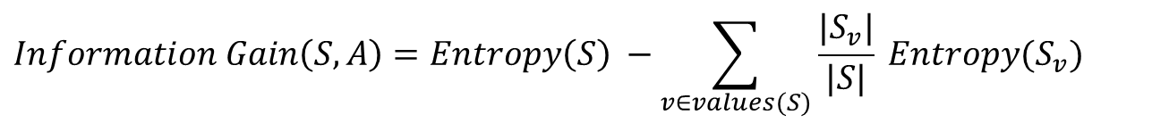
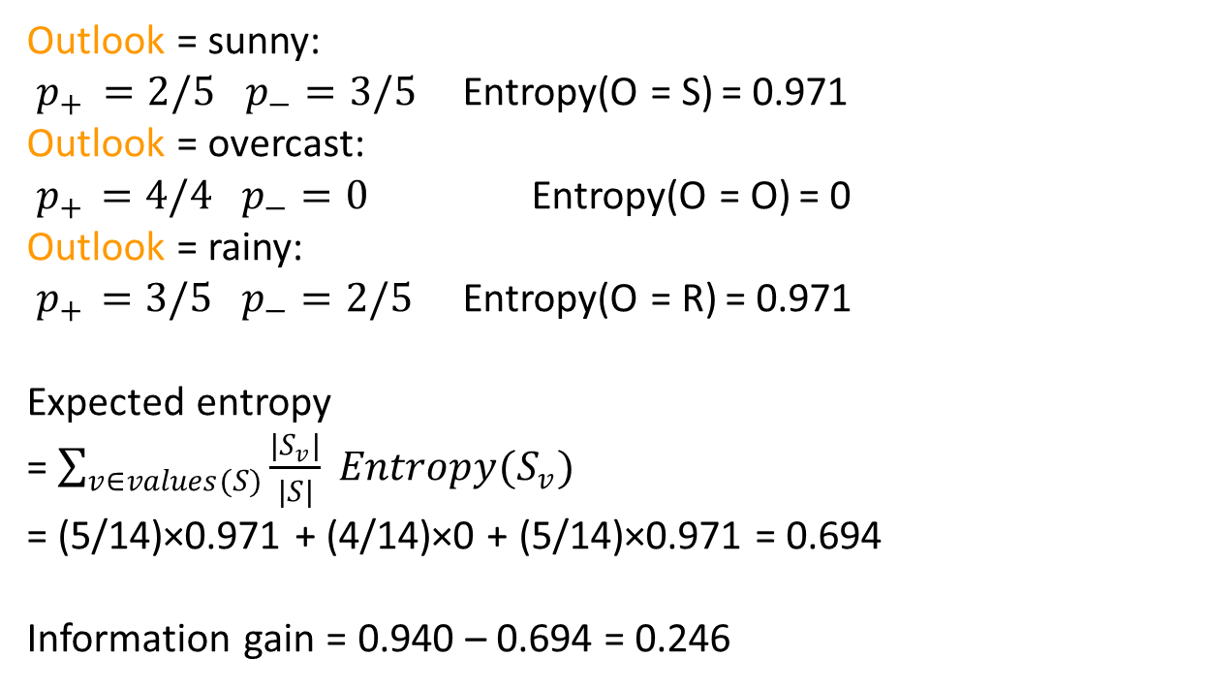
Example: Information Gain: Outlook
$$Information Gain\left(S,A\right)=Entropy\left(S\right) −\sum_{v∈values(S)}{\frac{|S_{v}|}{|S|} Entropy(S_{v})}$$
 | O | T | H | W | Play?
1 | S | H | H | W | -
2 | S | H | H | S | -
3 | O | H | H | W | +
4 | R | M | H | W | +
5 | R | C | N | W | +
6 | R | C | N | S | -
7 | O | C | N | S | +
8 | S | M | H | W | -
9 | S | C | N | W | +
10 | R | M | N | W | +
11 | S | M | N | S | +
12 | O | M | H | S | +
13 | O | H | N | W | +
14 | R | M | H | S | -
Outlook = sunny:
$p_{+ }=2/5$ $p_{−}=3/5$ Entropy(O = S) = 0.971
Outlook = overcast:
${ p}_{+ } =4/4$ $p_{−}=0$ Entropy(O = O) = 0
Outlook = rainy:
${ p}_{+ } =3/5$ $p_{−}=2/5$ Entropy(O = R) = 0.971
Expected entropy
= $\sum_{v∈values(S)}{\frac{|S_{v}|}{|S|} Entropy(S_{v})}$
= (5/14)×0.971 + (4/14)×0 + (5/14)×0.971 = 0.694
Information gain = 0.940 – 0.694 = 0.246

Slide 21
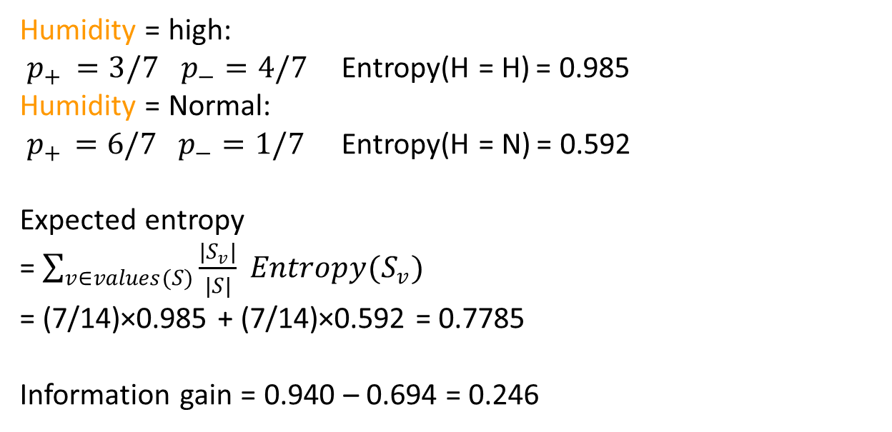
Example: Information Gain: Humidity
Information $Gain\left(S, A\right)=Entropy\left(S\right) −\sum_{v∈values(S)}{\frac{|S_{v}|}{|S|} Entropy(S_{v})}$
 | O | T | H | W | Play?
1 | S | H | H | W | -
2 | S | H | H | S | -
3 | O | H | H | W | +
4 | R | M | H | W | +
5 | R | C | N | W | +
6 | R | C | N | S | -
7 | O | C | N | S | +
8 | S | M | H | W | -
9 | S | C | N | W | +
10 | R | M | N | W | +
11 | S | M | N | S | +
12 | O | M | H | S | +
13 | O | H | N | W | +
14 | R | M | H | S | -
Humidity = high:
$p_{+ }=3/7$ $p_{−}=4/7$ Entropy(H = H) = 0.985
Humidity = Normal:
${ p}_{+ } =6/7$ $p_{−}=1/7$ Entropy(H = N) = 0.592
Expected entropy
= $\sum_{v∈values(S)}{\frac{|S_{v}|}{|S|} Entropy(S_{v})}$
= (7/14)×0.985 + (7/14)×0.592 = 0.7785
Information gain = 0.940 – 0.694 = 0.246

Slide 22
Gain ratio
Gain ratio: a modification of the information gain that reduces its bias on high-branch attributes
Gain ratio should be
  Large when data is evenly spread
  Small when all data belong to one branch
Gain ratio takes number and size of branches into account when choosing an attribute
  It corrects the information gain by taking the intrinsic information of a split into account (i.e. how much info do we need to tell which branch an instance belongs to)

Slide 23
Gain Ratio and Intrinsic Info.
Intrinsic information: entropy of distribution of instances into branches
Gain ratio normalizes info gain by:

Slide 24
Gain ratio
Suppose we have a dataset of 10 students deciding whether to play cricket, based on Weather (Sunny, Rainy).
Weather | Play?
Sunny | Yes
Sunny | Yes
Sunny | No
Sunny | No
Sunny | Yes
Rainy | Yes
Rainy | No
Rainy | No
Rainy | No
Rainy | Yes

Slide 25
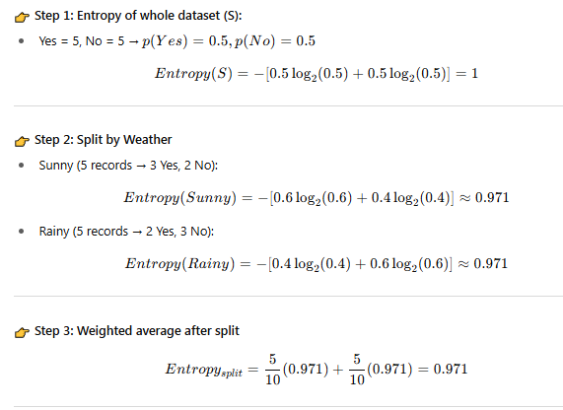
Gain ratio

Slide 26
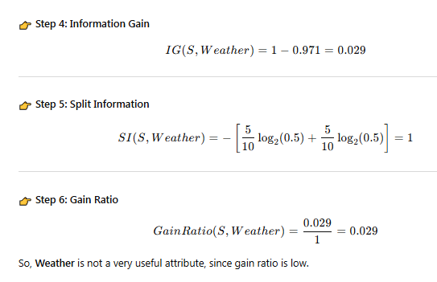
Gain ratio

Slide 27

THANK YOU!

